Slide 1
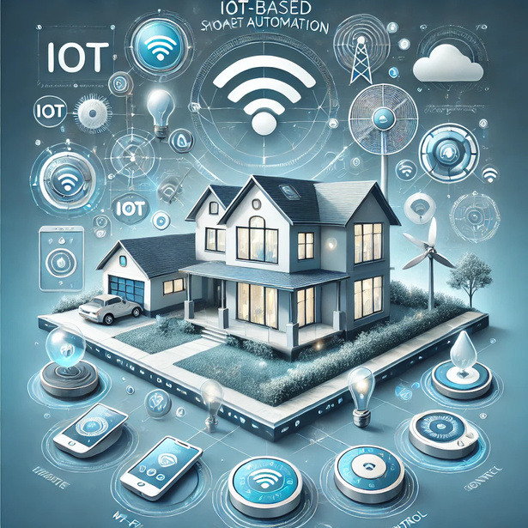

Eco Smart Home
GUIDED BY:-
Dr. Piyush Choudhary
Team members name:-
Noman Sameet
Kavish Prajapati
Mohammad Juned
Mohammad Zaki
Lavesh Patidar
Jayesh Koshti
1

Slide 2
Introduction
What is Smart Automation?
Smart Automation allows remote control of appliances using a mobile app.
Why IoT?
Internet of Things (IoT) enables automation through wireless control, making life more convenient and efficient.
Our system includes remote-controlled lights, fans, and a smart watering system in Garden.
2

Slide 3
Objectives of the Project
Automate garden watering using a mobile app .
Control home lights and fans remotely via a mobile app.
Improve energy efficiency and reduce unnecessary power consumption.
Provide a cost-effective and scalable solution for smart automation.
3

Slide 4
System Components
Hardware:
ESP32 (Microcontroller)
Soil Moisture Sensor
Relay Module
Water Pump
Light Bulbs & Fan
Power Supply (5V/12V Battery)
Software:
Arduino IDE (ESP32)
Blynk App (For mobile control)
4

Slide 5
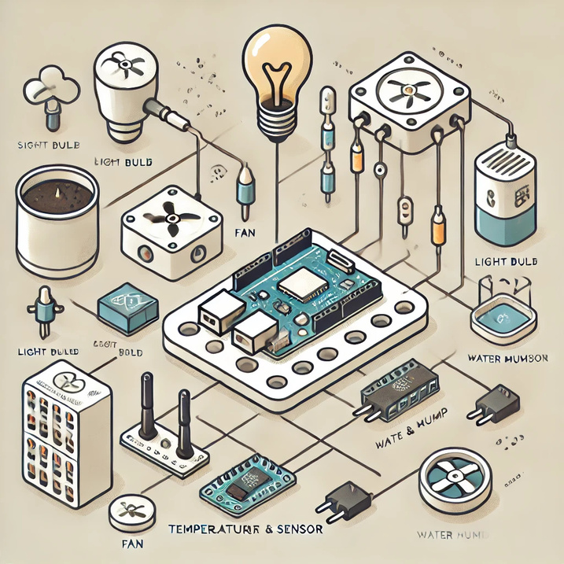

Circuit Diagram & System Architecture
Circuit Diagram: labeled diagram of ESP32, sensors, relays, and connected appliances.
Working Process:
Sensors detect inputs (moisture level, mobile command).
ESP32 processes data and controls the relay module.
Relays switch ON/OFF devices based on user input or automation rules.
Mobile app provides remote control.
5

Slide 6
Implementation & Working
Soil Moisture Sensor detects dry soil and activates the water pump.
Relay Module turns lights and fans ON/OFF based on mobile app commands.
Mobile App (Blynk ) enables remote access via Wi-Fi.
Wi-Fi Communication allows real-time control from anywhere.
User-friendly interface for easy operation.
6

Slide 7
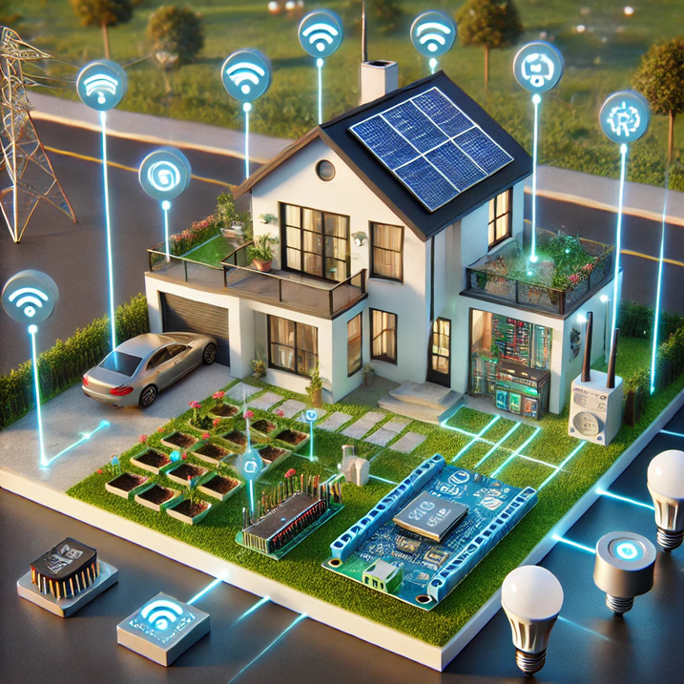
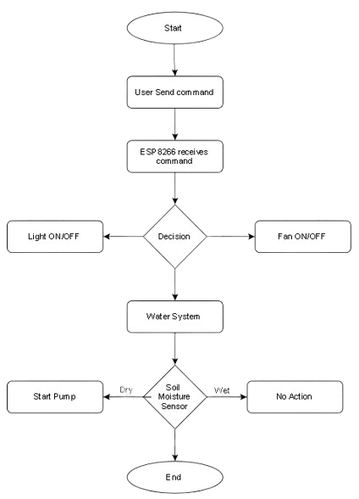
Sample Model
7

Slide 8
Advantages & Benefits
Advantages:
Convenience – Control appliances remotely.
Water & Energy Conservation – Avoid unnecessary usage.
Automation & Scheduling – No need for manual intervention.
Low Cost & Scalable – Affordable and expandable.
Smart Monitoring – Real-time control via mobile app.
Benefits for Us
Practical Learning: Hands-on experience in IoT & automation.
Career Opportunities: Skills in embedded systems, cloud computing, and app development.
Sustainability: Reducing water & electricity wastage.
8

Slide 9
Conclusion & Future Scope
Conclusion:
The project successfully implements an IoT-based smart home system that controls lights, fans, and garden watering remotely.
Future Enhancements:
Motion Sensors – Automatic light control.
Voice Control (Google Assistant / Alexa) – Hands-free operation.
Energy Monitoring System – Track power consumption.
9

Slide 10

Thank You
10

